Slide 1
Anders Zorn
His Personal, Professional Life and Work

Slide 2
Personal History
Anders Zorn is a passionate artist who was borne on 18th February 1860 and died on 22nd August 1920.
He passed on in Stockholm in Sweden. His nationality is Swedish.
He per took his education in Royal Swedish Academy of Arts in Stockholm.

Slide 3
His wife was known as Emma Lamm.
He was raised in his grandparents' farm which is located in Yvraden, Utmeland village, Mora Darlan parish.
In his primary education, he studied in a school situated in Mora Strand and later relocated to a school in Enkoping for his secondary education.

Slide 4
It is at the Royal Swedish Academy of Arts in Stockholm whereby the teachers discovered his incredible talent.
He was so excellent to the extent of being approached by various members of the town with an offer of commissions.
Through the interaction with the community members, he managed to meet his beautiful wife, Emma. She was from a wealthy family, unlike Zorn who was from a humble background.

Slide 5
Professional History
The success of Anders Zorn was known for his careers and specializations which included a painter, etcher and a sculptor.
His portrait subjects included Grover Cleveland, King Oscar II (Sweden), William H. Taft and Theodore Roosevelt.

Slide 6
During his last days, he managed the Bellman Prize which was awarded to him regarding the field of Swedish literary in 1920.
Also, whenever he traveled abroad, he would carry with him some of his famous pieces of art and surprisingly they would all be purchased.

Slide 7
Also, he placed some of his most treasured paintings in museums such as National Museum of Fine Arts (Stockholm, Sweden), Museum d'Orsay (Paris) and Metropolitan Museum of Art (New York, United States).
This provided a chance for his excruciate work to be viewed in significant parts of the world.

Slide 8
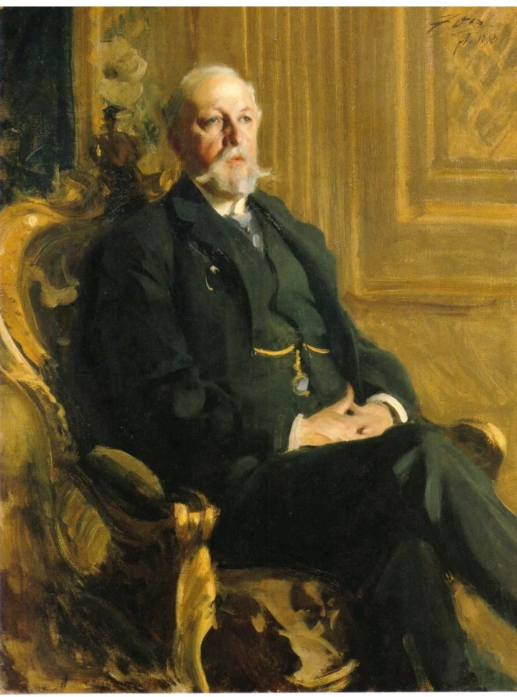
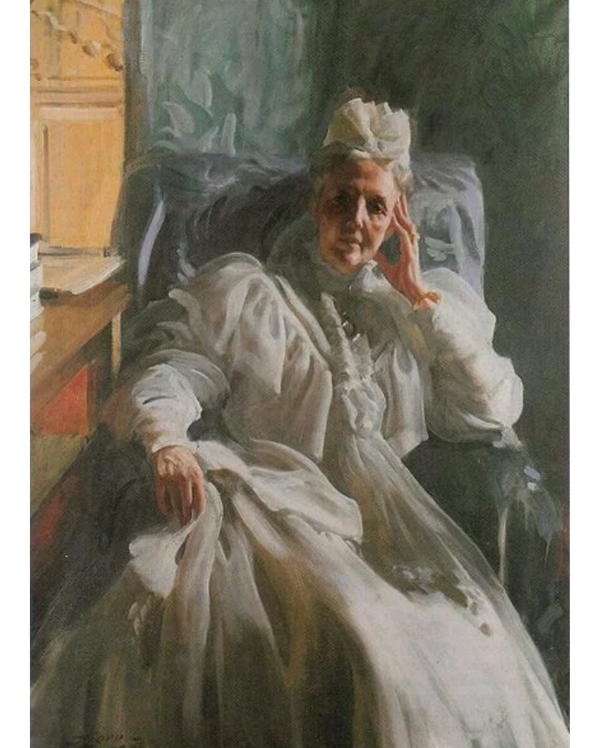
Work Examples
Amongst the best of Zorn's work were as follows;
The king of Sweden, King Oscar II which was made in 1898
The queen consort of Sweden and Norway, Queen Sophia, created in 1909

Slide 9
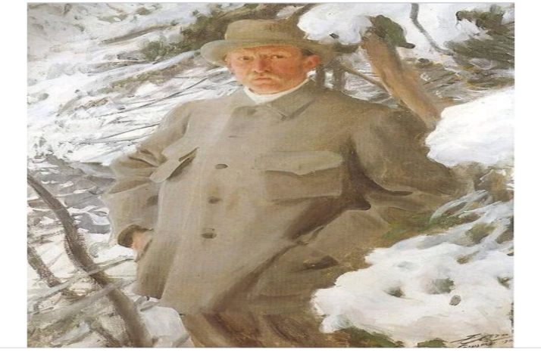
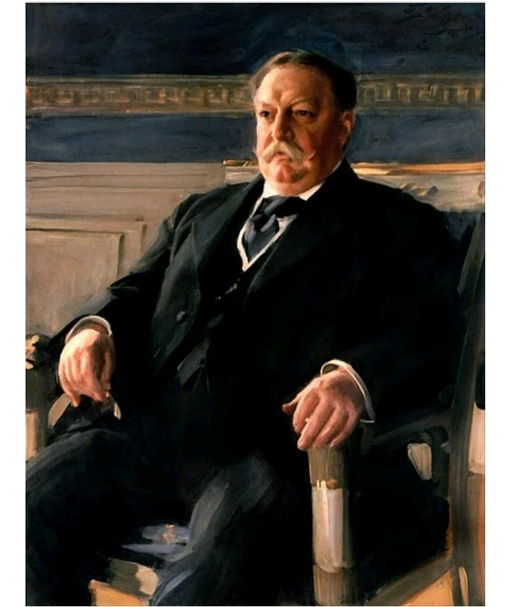
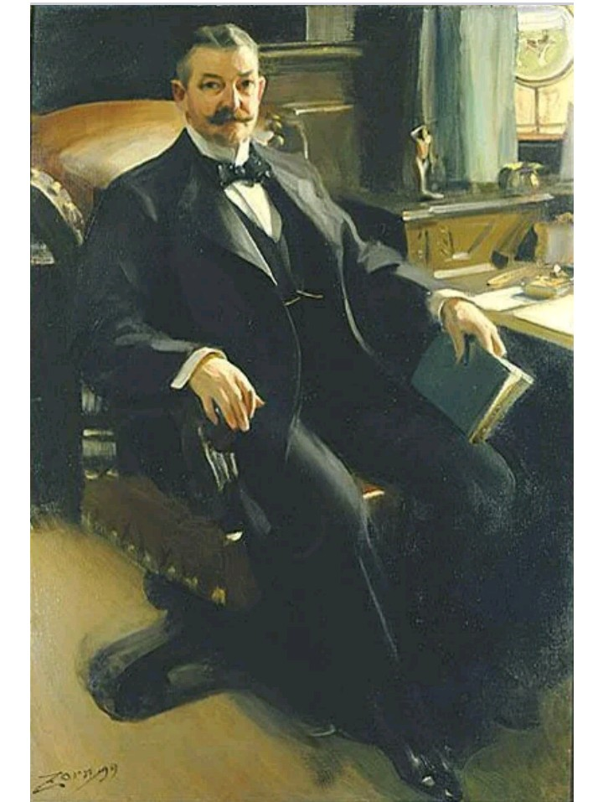
The painter Bruno Lifefors, made in 1906
William Howard Taft, 27th America's President, made in 1911
Mr. Henry Clay Pierce (oil industry pioneer and a noted financier), made in 1899

Slide 10
The above portraits are just but a few of what made him wealthy in the industry of art.
He, therefore, decided to start up an art collection whereby he positioned his work in several art galleries and museums whereby people would visit to view.

Slide 11
This is precisely how he made most of his money in addition to the individual portraits that he made for famous icons around the world.

Slide 12
Reference
Asplund, K. (1921). “Anders Zorn: His Life and Work.” The Studio.

